Slide 1
Animation
Concepts and Examples

Slide 2
Animation
Animation is the combination of sequential images, that are subtly different, displayed over a period of time to create the illusion of movement within a singular picture space.
Most people are familiar with the concept. But there are tricks and tips that help the illusion look more convincing.
The most important rule is to keep changes between images gradual in order to create fluidity.

Slide 3
Forms of Animation
Several forms of animation have been popular at different periods of time. Some of these forms include
Cel animation – hand drawn pictures
Rotoscoping – drawn images on film
Stop motion – pictures or objects, manipulated between captured frames
Computer Animation (2D) – 2d bitmap graphics
Computer Animation (3D) – 3d digital models

Slide 4
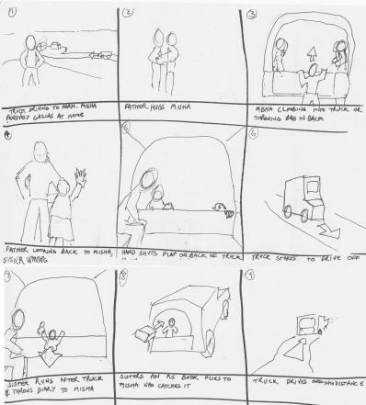
Pre-planning/ Storyboarding
The Storyboard helps to finalize the development of the storyline, and is an essential stage of the animation process.
Each cell is called a Keyframe, and represents a moment in the animation when something important happens or the scene changes.
It is made up of drawings in the form of a comic strip, and is used to both help visualize the animation and to communicate ideas clearly.
Not only can storyboards be especially useful when working in group environments (something quite common in the animation industry,) but they also provide a visual reminder of the original plan;
Notes:
Each cell is called a key Frame. It’s a moment in the animation when something important happens or changes.

Slide 5
Framing your shot
It is important to be aware of how the camera is setup.
The camera should be set-up on a tripod to keep it from moving around too much. Unless “shaky” cam is your intention.
Turn off autofocus on the camera.
Set your camera to auto exposure, but don’t use your flash.
Avoid zooming in and zooming out randomly.
Make sure to light your scene so that you can see the action. Desk lamps, studio lights, clamp lights, sunlight… all acceptable.
Find your frame (the composition of the scene), once you’ve found it, remember it!
Notes:
T4i settings for Fine 100
Start by clearing all settings on the camera.
On the camera:
Set camera to “P” auto exposure but no flash
Set ISO to 800 - good general setting for indoor shooting
Turn off auto focus
In the menu:
Image Quality – set to S2 (1920X1280 px)
Image review – 2 seconds (could also be set to none for faster shooting)
Red-eye reduction – Disabled
Live-View shoot – Enabled
Grid – personal option ( I like Grid 2, for its hirer accuracy, but its not necessary)
Aspect ratio – 16:9
File numbering continuous
Auto power off: 4 minutes (pain to keep turning it back on)

Slide 6
Playback Speed/ The Frame Rate
The way an animation looks is controlled by the chosen frame rate. (fps)
The faster the frame rate the more fluid the animation looks. (Slower frame rates look choppier)
The human eye needs between 15 and 20 frames per second to in order to perceive that the images are moving.
This works because our eye can still recognize shapes but it will also have a tendency to skip extra data due to the blurring effect.
You should know your frame rate before you begin shooting with the camera. It determines how many pictures you need to take. I recommend around 24 fps, but 15 fps (minimum) is acceptable.

Slide 7
Frame Rates
Typical frame rates include:
24 fps – 35 film (Cinema)
30 fps – Standard Interlaced Video
60 fps – Standard Progressive Video
15 fps – Some internet animations

Slide 8
Timing & Motion Enhancements
It is difficult to convey some motions without exaggerating them in some way. For example:
Falling bodies - To give the impression of something falling continuously, put some texture or an object in the background that travels in the opposite direction as the main object is tracked.
Rolling Balls - To show a ball rolling down an inclined plane, add a simple line to the ball (something that makes the circle asymmetrical). This represents a highlight. When the ball is rolled down the plane, the highlight rotates with it looking just like a moving mark on the surface of the ball.
Overlapping action – having various actions overlap in time makes an animation feel more alive.
Gradual movements – Again the important rule is to keep changes between images gradual in order to create fluidity.

Slide 9
Examples and Discussion
http://www.youtube.com/watch?v=qBjLW5_dGAM
Western Spaghetti by PES
http://www.youtube.com/watch?v=uuGaqLT-gO4
MUTO a wall-painted animation by BLU
Notes:
http://vimeo.com/33348536 Kelly Richardson
UWAG Show
November 7–December 21, 2013 Opening Reception: Thursday, November 7 from 5:00–8:00 pm

Slide 10
Things to consider while working
When you are creating an animation how you animate something is as important as what you animate.
Pre-plan, especially important in a team project.
Think about the timeline. What is happening at the beginning, middle and end? Is there a beginning, middle and end?
What is the message you want to communicate?
Story matters, even when you aren’t trying to tell one.
Detail matters, ask yourselves why each detail is there, shapes, backgrounds, etc…
Notes:
Show student examples
Demo the process, camera use, tripod use, sequentially numbered images, importing to Photoshop to make the movie.

